Slide 1



POWER ALLOCATION, ADAPTIVE BEAMFORMING IN LTE THROUGH PILOT-BASED CHANNEL ESTIMATION
MAJOR PROJECT EXTERNALS
INTERNAL GUIDE
PROF. SHUSHRUTHA K S
EXTERNAL GUIDE
DR. SAPTARSHI CHAUDHURI
1. | MOHAMED OMAR SHARIEF K | 1RV12EC089
2. | NIKHIL MAHADEVAPPA KALLER | 1RV12EC103
3. | PRABHASA K | 1RV12EC111
R.V.COLLEGE OF ENGINEERING, 21-5-2016

Slide 2
PRESENTATION FLOW
INTRODUCTION
LTE PHY MODULATION AND CODING
PILOT-BASED CHANNEL ESTIMATION
POWER ALLOCATION
ADAPTIVE BEAMFORMING
FUTURE WORK
REFERENCES
R.V.COLLEGE OF ENGINEERING, 21-5-2016

Slide 3
INTRODUCTION
LTE PHY MODULATION AND CODING
PILOT-BASED CHANNEL ESTIMATION
POWER ALLOCATION
ADAPTIVE BEAMFORMING
FUTURE WORK
REFERENCES
R.V.COLLEGE OF ENGINEERING, 21-5-2016

Slide 4
INTRODUCTION
LITERATURE SURVEY
MOTIVATION
PROBLEM STATEMENT
OBJECTIVES
METHODOLOGY
SPECIFICATIONS
R.V.COLLEGE OF ENGINEERING, 21-5-2016

Slide 5
PROBLEM STATEMENT
In a wireless, multi-user, mobile environment, Base Station antennas must:
Dynamically steer the signal (beam) to the User Equipment
With a suitable power
Based on channel conditions
STATEMENT – MATLAB implementation of power allocation and adaptive beamforming through a [UE location, Power required] look-up table based on downlink channel conditions and path loss
R.V.COLLEGE OF ENGINEERING, 21-5-2016

Slide 6
OBJECTIVES
Understanding of LTE-PHY and enabling technologies
Recreate modules that implement Modulation and Coding
Pilot-based OFDM Channel Estimation
Path Loss calculation
Distance Based Power allocation
Adaptive beam-steering through antenna array
R.V.COLLEGE OF ENGINEERING, 21-5-2016

Slide 7
METHODOLOGY
Understanding of LTE-PHY and enabling technologies
Recreate modules that implement Modulation and Coding
Pilot-based OFDM Channel Estimation
Path Loss calculation
Distance Based Power allocation
Adaptive beam-steering through antenna array
R.V.COLLEGE OF ENGINEERING, 21-5-2016

Slide 8
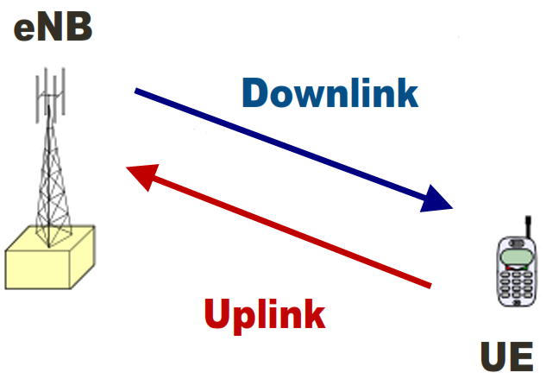
LTE NOMENCLATURE
eNB = Enhanced Node Base Station
UE = User Equipment
R.V.COLLEGE OF ENGINEERING, 21-5-2016

Slide 9
BLOCK DIAGRAM
PILOT-BASED CHANNEL ESTIMATION
MODULATION AND CODING BLOCKS
PILOT SYMBOL GENERATION
CHANNEL ESTIMATION
PILOT SYMBOL EXTRACTION
DEMODULATION AND DECODING BLOCKS
ADAPTIVE BEAMFORMING FOR USER DATA
POWER ALLOCATION
PATH LOSS CALCULATION
R.V.COLLEGE OF ENGINEERING, 21-5-2016

Slide 10
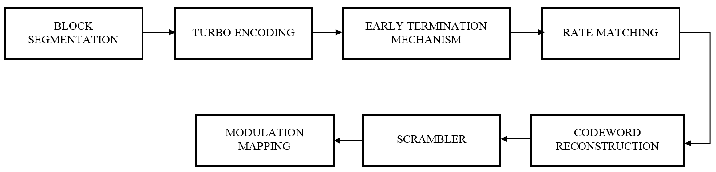
LTE PHY MODULATION AND CODING
R.V.COLLEGE OF ENGINEERING, 21-5-2016

Slide 11
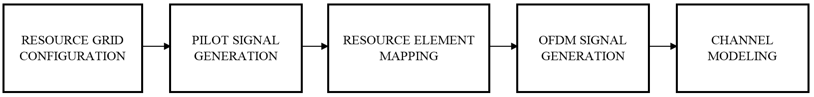

PILOT-BASED DOWNLINK OFDM CHANNEL ESTIMATION
R.V.COLLEGE OF ENGINEERING, 21-5-2016

Slide 12
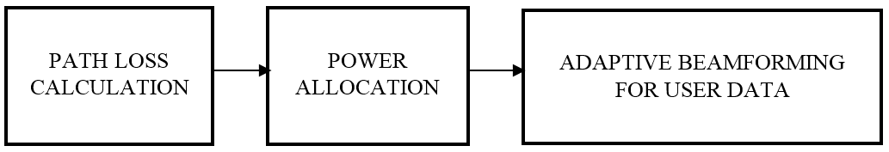
POWER ALLOCATION, ADAPTIVE BEAMFORMING
R.V.COLLEGE OF ENGINEERING, 21-5-2016

Slide 13
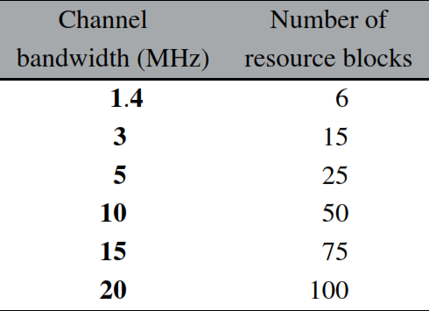
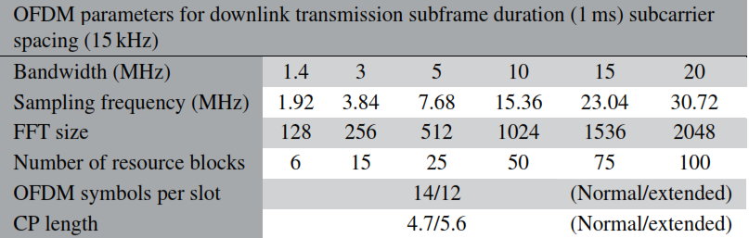
SPECIFICATIONS - LTE PARAMETERS
R.V.COLLEGE OF ENGINEERING, 21-5-2016

Slide 14
SPECIFICATIONS - LTE PARAMETERS
Specification No. | Description
TS 36.101 | User Equipment (UE) radio transmission and reception
TS 36.104 | Base Station (eNodeB) radio transmission and reception
TS 36.201 | LTE physical layer: General description
TS 36.211 | Physical channels and modulation
TS 36.212 | Multiplexing and channel coding
TS 36.213 | Physical layer procedures
TS 36.214 | Physical layer measurements
TS 36.305 | Functional specification of User Equipment (UE) positioning
TR 36.824 | LTE coverage enhancements
TR 36.863 | Study on Cell-specific Reference Signals (CRS)
TR 36.897 | Study on Elevation Beamforming for LTE
R.V.COLLEGE OF ENGINEERING, 21-5-2016

Slide 15
Sl No | Parameter | Specifications
1 | LTE Version | Release 8
2 | Layer involved | LTE PHY – Layer 1
3 | Mode and Duplexing | Downlink, FDD
4 | Frequency Bands | 25 for FDD, 11 for TDD
5 | Frequency range | 1.9 GHz to 3.8 GHz
6 | Subcarrier spacing | 15kHz
7 | Channel Bandwidth (LTE specified) | 1.4-20 MHz
8 | Number of Resource Blocks (Depends on BW) | 6-100
9 | Subcarrier per Resource Block | 12
10 | OFDM symbols per Resource Block | 7
11 | Types of Channel Information | 6
Sl No | Block | Specifications
1 | Modulator/Demodulator (Adaptive) | QPSK, 16-QAM, 64-QAM
2 | Scrambler/Descrambler | Number of shift registers:31
3 | Turbo Encoder/Decoder | Rate: 1/3, Block Size: 40-6144
4 | CRC Generator/Detector | Length: 24 bits
5 | FFT (Block size depends on Bandwidth used) | Size: 128-2048
R.V.COLLEGE OF ENGINEERING, 21-5-2016

Slide 16
INTRODUCTION
LTE PHY MODULATION AND CODING
PILOT-BASED CHANNEL ESTIMATION
POWER ALLOCATION
ADAPTIVE BEAMFORMING
FUTURE WORK
REFERENCES
R.V.COLLEGE OF ENGINEERING, 21-5-2016

Slide 17
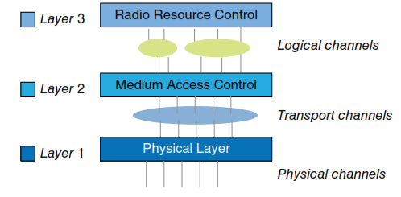
METHODOLOGY
Understanding of LTE-PHY
Downlink – eNodeB to UE
Air Interface – OFDM
Enabling Technologies
MIMO – MU-MIMO
TX, RX DIVERSITY
LINK ADAPTATION
LTE MODEL
R.V.COLLEGE OF ENGINEERING, 21-5-2016

Slide 18
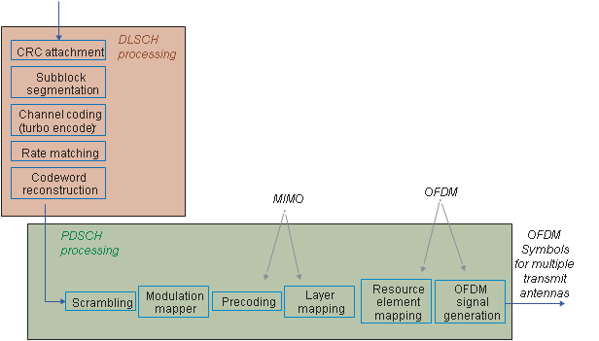
METHODOLOGY
Modulation and Coding
Adaptive Modulation – QPSK/16-QAM/64-QAM
Scrambling – Gold sequence (31 bits)
Turbo Coding (Rate 1/3)
Open source codes
Rate Matching
Codeblock Segmentation
Channel Processing
Reverse sequence at receiver
R.V.COLLEGE OF ENGINEERING, 21-5-2016

Slide 19
RESULTS – ADAPTIVE MODULATION
INPUT PARAMETERS
ModulationMode
EbNo (SNR)
maxNumErrors = 200
maxNumBits = 10^7
R.V.COLLEGE OF ENGINEERING, 21-5-2016

Slide 20
RESULTS - SCRAMBLING
INPUT PARAMETERS
ModulationMode
EbNo (SNR)
maxNumErrors = 200
maxNumBits = 10^7
R.V.COLLEGE OF ENGINEERING, 21-5-2016

Slide 21
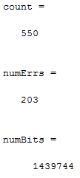
RESULTS – TURBO CODING
R.V.COLLEGE OF ENGINEERING, 21-5-2016

Slide 22
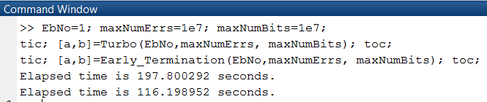
RESULTS – EARLY TERMINATION
Turbo Coding consumes almost 90% of runtime so far
This can be reduced by generating CRC bits
Only last 24 CRC bits checked, thereby reducing runtime
R.V.COLLEGE OF ENGINEERING, 21-5-2016

Slide 23
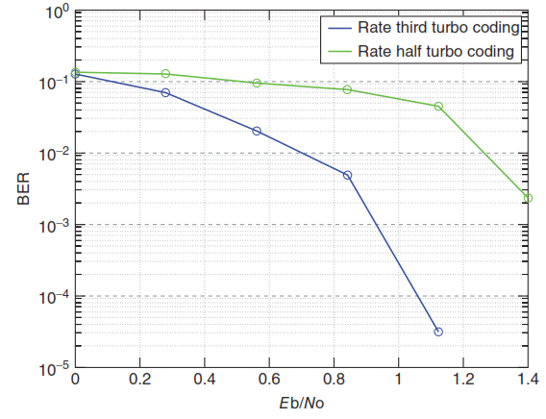
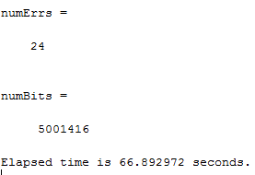
RESULTS – RATE MATCHING
R.V.COLLEGE OF ENGINEERING, 21-5-2016

Slide 24
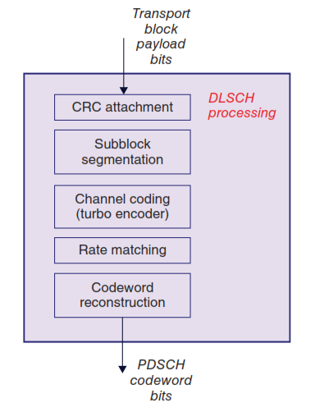
OVERALL BLOCK 1
R.V.COLLEGE OF ENGINEERING, 21-5-2016

Slide 25
METHODOLOGY
Pilot-based OFDM Channel Estimation
Multipath Fading – Frequency Selective
Mobility – Doppler Effect
Resource Grid Configuration
Six types of signals
CSR – Pilot Signals
Reference Generation – Open Source
Resource Element Mapping
OFDM Signal Generation
Channel Modeling and Estimation
R.V.COLLEGE OF ENGINEERING, 21-5-2016

Slide 26
INTRODUCTION
LTE PHY MODULATION AND CODING
PILOT-BASED CHANNEL ESTIMATION
POWER ALLOCATION
ADAPTIVE BEAMFORMING
FUTURE WORK
REFERENCES
R.V.COLLEGE OF ENGINEERING, 21-5-2016

Slide 27
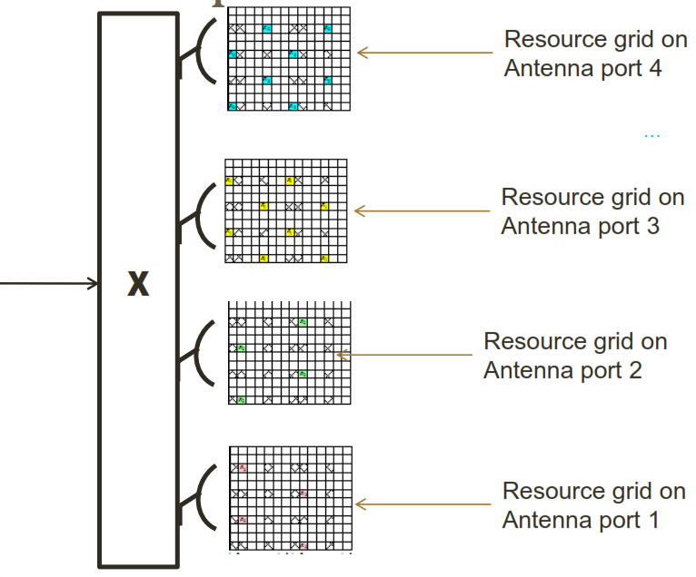
RESOURCE GRID ON ANTENNA PORTS
27
R.V.COLLEGE OF ENGINEERING, 21-5-2016

Slide 28
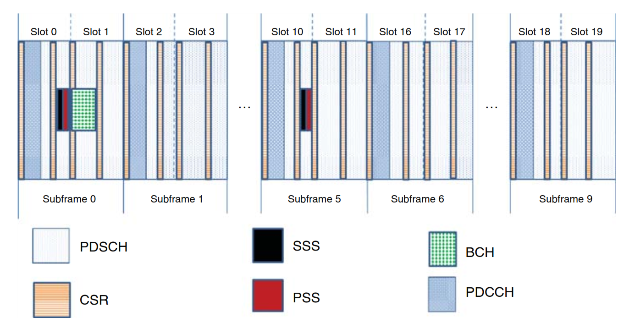
LTE RESOURCE GRID
28
R.V.COLLEGE OF ENGINEERING, 21-5-2016

Slide 29
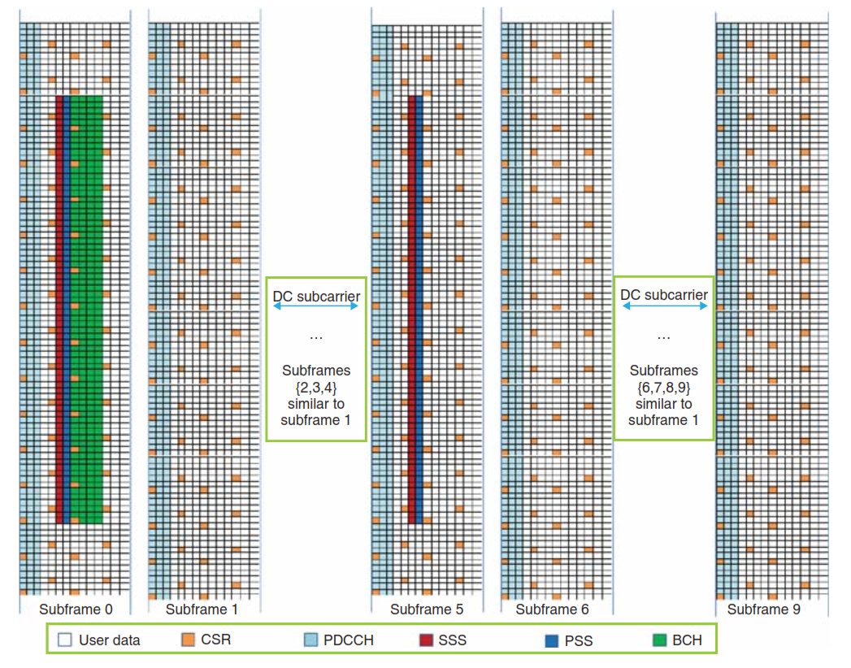
29
R.V.COLLEGE OF ENGINEERING, 21-5-2016

Slide 30
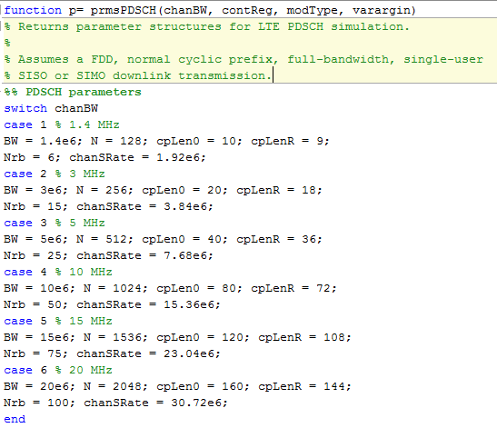
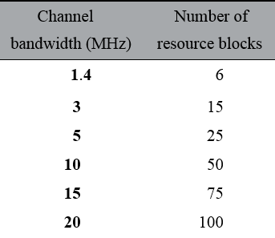
RESOURCE GRID CONFIGURATION
R.V.COLLEGE OF ENGINEERING, 21-5-2016

Slide 31
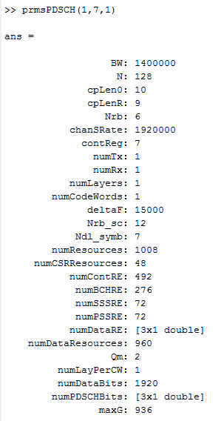
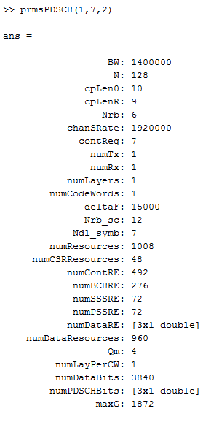
RESULTS – Fixed BW, Varying Modulation Scheme (QPSK, 16-QAM)
R.V.COLLEGE OF ENGINEERING, 21-5-2016

Slide 32
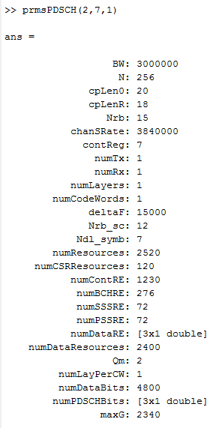
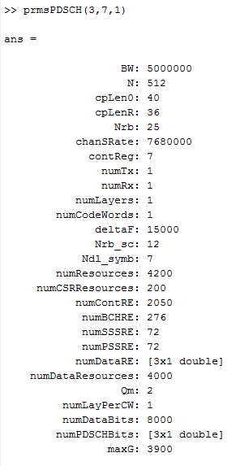
RESULTS – Varying BW (1.4, 3, 5 MHz) Fixed Modulation Scheme
R.V.COLLEGE OF ENGINEERING, 21-5-2016

Slide 33
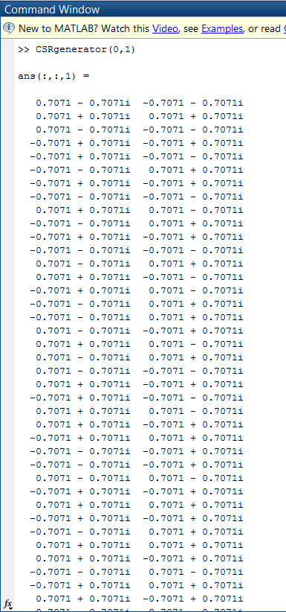
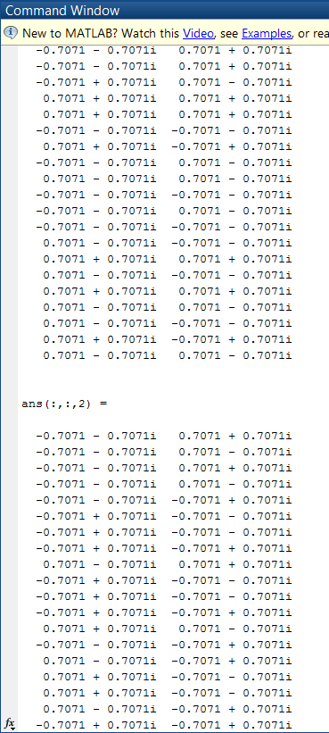
RESULTS – PILOT SIGNAL GENERATION
R.V.COLLEGE OF ENGINEERING, 21-5-2016

Slide 34
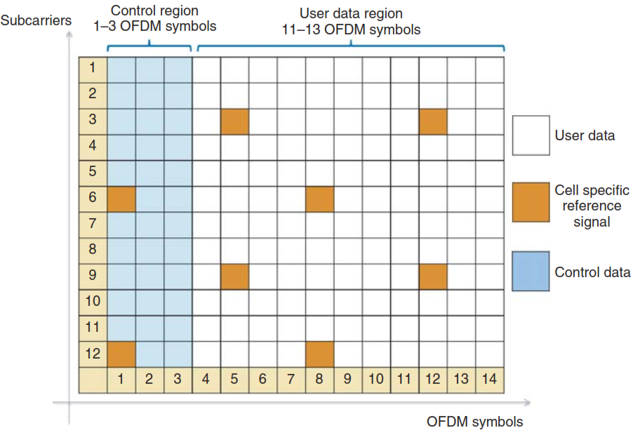
RESULTS – RESOURCE ELEMENT MAPPING
One Resource Block has 12 subcarriers of 15kHz each. For BW = 1.4MHz, there will be 6 Resource Blocks
One Subframe has 14 OFDM symbols. A frame is made up of 10 subframes
R.V.COLLEGE OF ENGINEERING, 21-5-2016

Slide 35
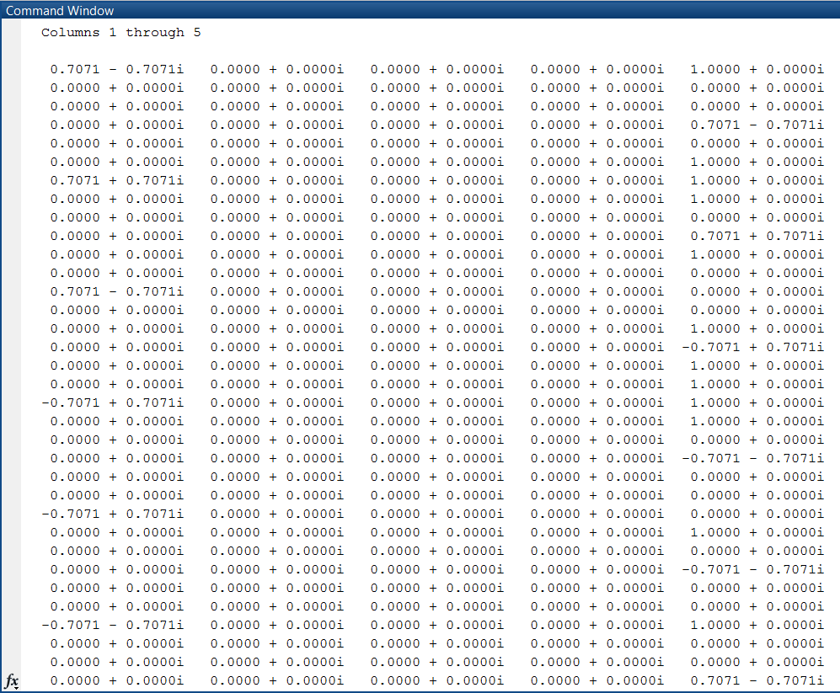
RESULTS – RESOURCE ELEMENT MAPPING
R.V.COLLEGE OF ENGINEERING, 21-5-2016

Slide 36
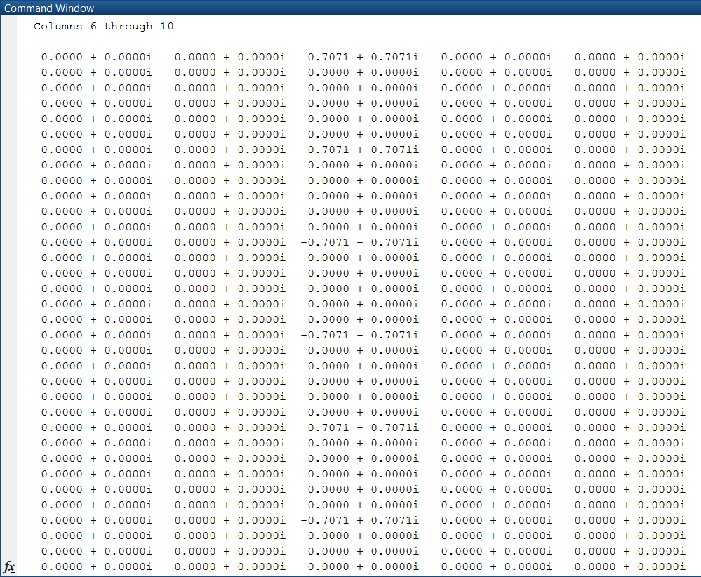
RESULTS – RESOURCE ELEMENT MAPPING
R.V.COLLEGE OF ENGINEERING, 21-5-2016

Slide 37
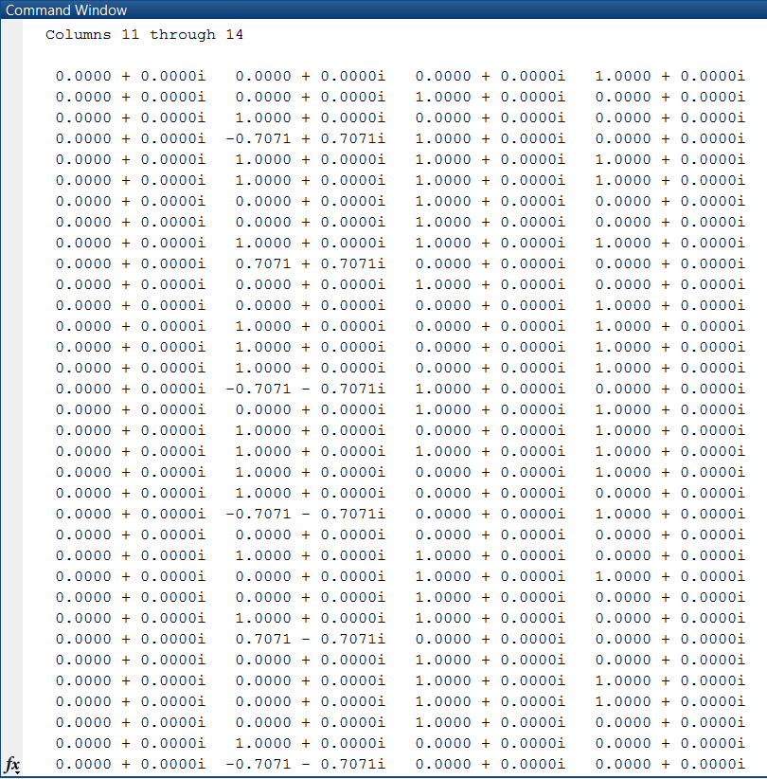
RESULTS – RESOURCE ELEMENT MAPPING
R.V.COLLEGE OF ENGINEERING, 21-5-2016

Slide 38
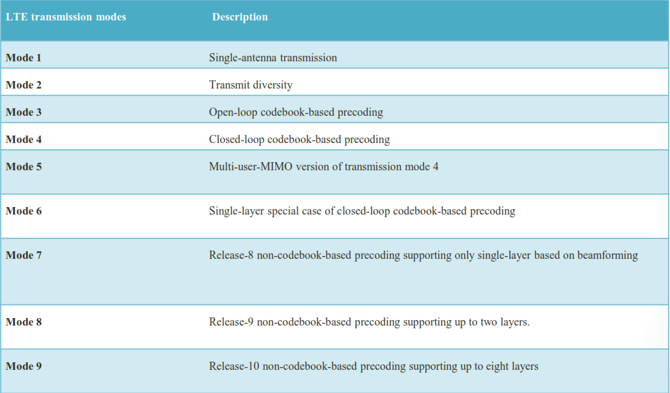
MIMO TRANSMISSION MODES
R.V.COLLEGE OF ENGINEERING, 21-5-2016

Slide 39
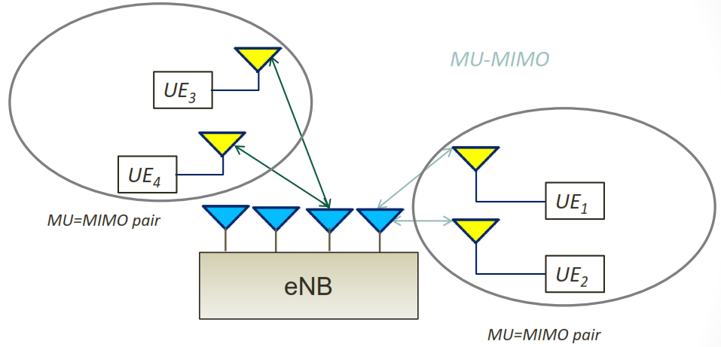
TRANSMISSION MODE 5 – MULTIUSER MIMO
R.V.COLLEGE OF ENGINEERING, 21-5-2016

Slide 40
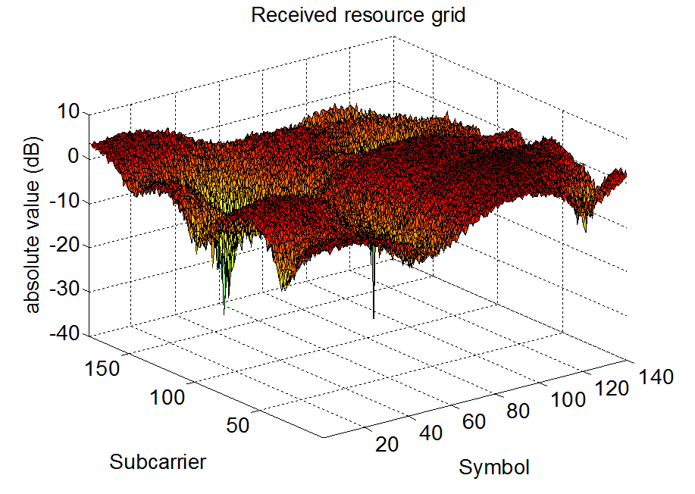
EQUALIZER EFFECT
R.V.COLLEGE OF ENGINEERING, 21-5-2016

Slide 41
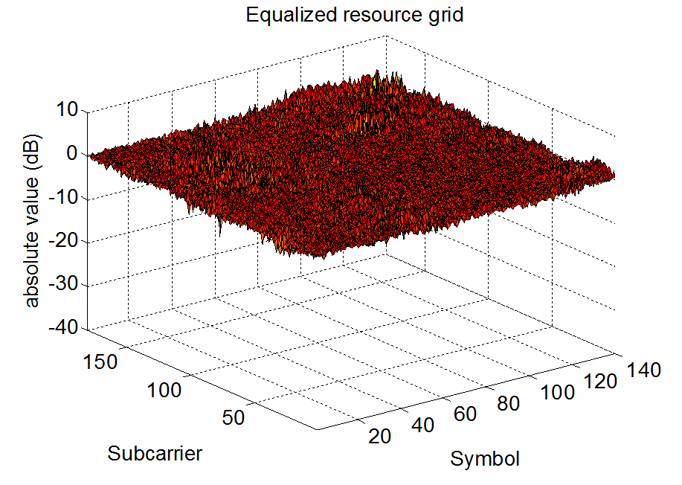
EQUALIZER EFFECT
R.V.COLLEGE OF ENGINEERING, 21-5-2016

Slide 42
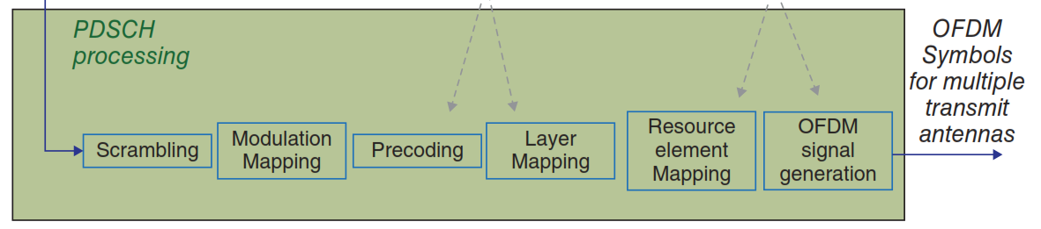
OVERALL BLOCK 2 AND 3
R.V.COLLEGE OF ENGINEERING, 21-5-2016

Slide 43
INTRODUCTION
LTE PHY MODULATION AND CODING
PILOT-BASED CHANNEL ESTIMATION
POWER ALLOCATION
ADAPTIVE BEAMFORMING
FUTURE WORK
REFERENCES
R.V.COLLEGE OF ENGINEERING, 21-5-2016

Slide 44
METHODOLOGY
Path Loss calculation
P_{t} – Transmitted Power (Notified to UE)
P_{r} – Received Power (Measured by UE)
10*log (P_{t} / P_{r}) – Path Loss
Okumura Hata Model
P_{loss} = 69.55 + 26.16*log10(frequency) - 13.82*log10(h_{te}) + (44.9 - 6.55*log10(h_{te}))*log10(distance);
Rearranged Okumura Hata Model
Distance = 10.^((P_{loss} - 69.55 - 26.16*log10(frequency) + 13.82*log10(h_{te}))/(44.9 - 6.55*log10(h_{te})));
R.V.COLLEGE OF ENGINEERING, 21-5-2016

Slide 45
RESULTS
R.V.COLLEGE OF ENGINEERING, 21-5-2016

Slide 46
RESULTS
R.V.COLLEGE OF ENGINEERING, 21-5-2016

Slide 47
METHODOLOGY
Determination of (r,θ) of user – DoA Estimation – MUSIC Algorithm
Power allocation – Power Control through Open-loop Feedback Techniques
(r,P) Look-up table for entire cell – Obtaining relation between the two variables
Repeating entire process for multi-user MIMO
R.V.COLLEGE OF ENGINEERING, 21-5-2016

Slide 48
Downlink Power Control
Power control refers to the strategies or techniques required in order to adjust, correct and manage the power from the base station and the mobile station in an efficient manner.
It minimises the necessary transmission power level to achieve good quality of service. This reduces the co-channel interference in other cells, which increases the system capacity.
Open-loop power control
R.V.COLLEGE OF ENGINEERING, 21-5-2016

Slide 49
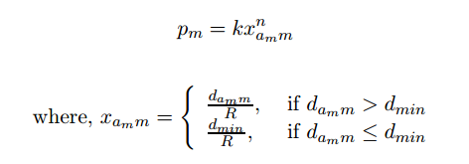
Distance Based Power Allocation
The distance-based power allocation algorithm (DBPA) uses the distance between base station and each mobile station to allocate transmitted power to each each of its served mobile.
The DBPA algorithm computes the transmitted power of mobile m according to the following equation:
k=positive constant, R=maximum range, n= real positive value,d= distance between MS and BS.
R.V.COLLEGE OF ENGINEERING, 21-5-2016

Slide 50
RESULTS-DBPA
R.V.COLLEGE OF ENGINEERING, 21-5-2016

Slide 51
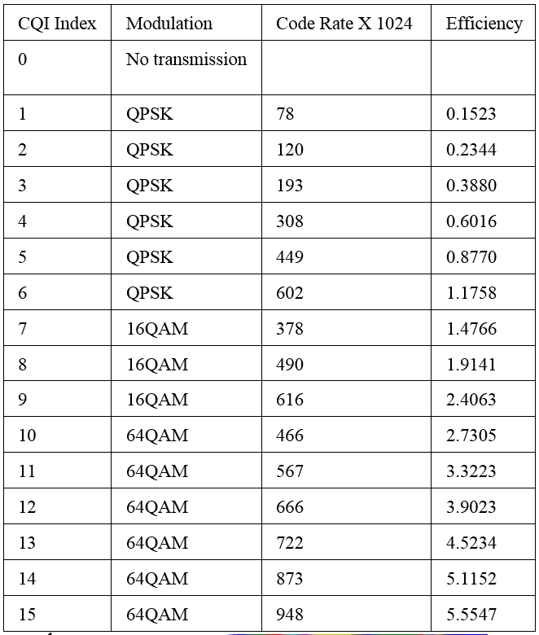
RESULTS-DBPA
R.V.COLLEGE OF ENGINEERING, 21-5-2016

Slide 52
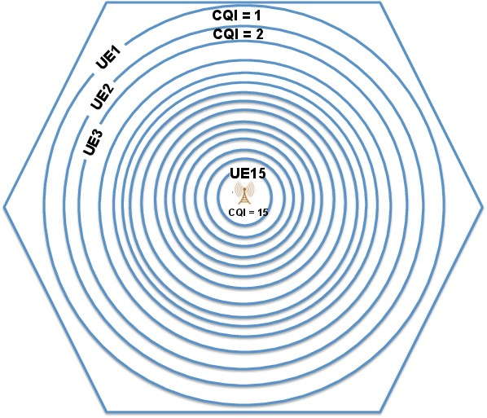
RESULTS-DBPA
R.V.COLLEGE OF ENGINEERING, 21-5-2016

Slide 53
RESULTS-DBPA
R.V.COLLEGE OF ENGINEERING, 21-5-2016

Slide 54
INTRODUCTION
LTE PHY MODULATION AND CODING
PILOT-BASED CHANNEL ESTIMATION
POWER ALLOCATION
ADAPTIVE BEAMFORMING
FUTURE WORK
REFERENCES
R.V.COLLEGE OF ENGINEERING, 21-5-2016

Slide 55
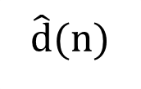
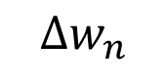
METHODOLOGY
Adaptive beam-steering from antenna – LMS Algorithm
$$\hat{d}(n)$$
Variable filter
w_{n}
+
x(n)
d(n)
$$∆w_{n}$$
e(n)
Update
Algorithm
BLOCK DIAGRAM
R.V.COLLEGE OF ENGINEERING, FEBRUARY 2016

Slide 56
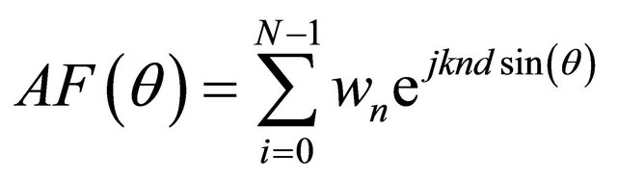
METHODOLOGY
MATHEMATICAL MODELING
ANTENNA ARRAY PATTERN – For n arrays, separated by a uniform distance d, oriented at angle θ, having weights w_{n}, Array Factor (AF) is given as:
BEAMFORMING ALGORITHM – The weights for LMS algorithm is given as:
R.V.COLLEGE OF ENGINEERING, FEBRUARY 2016

Slide 57
METHODOLOGY
MATHEMATICAL MODELING
ANTENNA ARRAY PATTERN – For n arrays, separated by a uniform distance d, oriented at angle θ, having weights w_{n}, Array Factor (AF) is given as:
BEAMFORMING ALGORITHM – The weights for LMS algorithm is given as:
R.V.COLLEGE OF ENGINEERING, FEBRUARY 2016

Slide 58
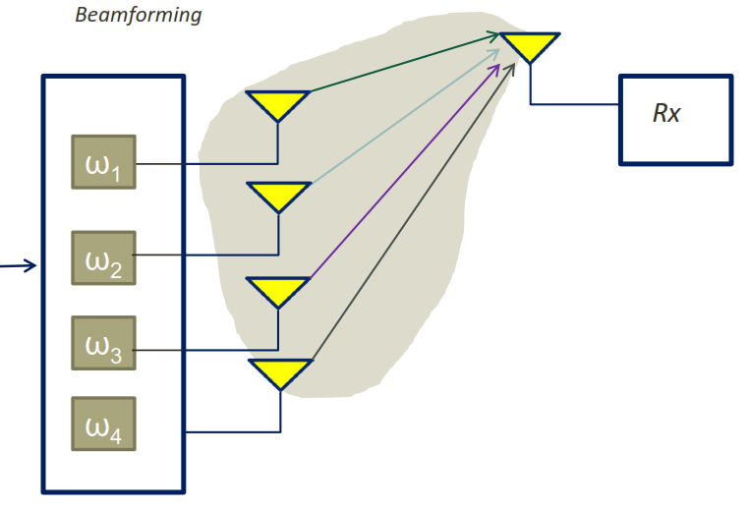
TRANSMISSION MODE 7 – UE BEAMFORMING
R.V.COLLEGE OF ENGINEERING, 21-5-2016

Slide 59
RESULTS
Desired signal arrives at an angle of 45 degrees – MAXIMISE POWER
Interferer signals arrive at 30, 60 degrees – STEER NULLS
POLAR, AMPLITUDE PATTERN OF RECEIVED BEAM – MAXIMA AT 45 DEGREES, NULLS AT 30, 60 DEGREES
R.V.COLLEGE OF ENGINEERING, 21-5-2016

Slide 60
RESULTS
SAME DIRECTIONAL VALUES WITH NUMBER OF ANTENNAS INCREASED FROM 5 TO 10
R.V.COLLEGE OF ENGINEERING, 21-5-2016

Slide 61
INTRODUCTION
LTE PHY MODULATION AND CODING
PILOT-BASED CHANNEL ESTIMATION
POWER ALLOCATION, ADAPTIVE BEAMFORMING
FUTURE WORK
REFERENCES
R.V.COLLEGE OF ENGINEERING, 21-5-2016

Slide 62
FUTURE SCOPE – AT WIPRO
IMPLEMENTATION OF MIMO, LINK ADAPTATION ALGORITHMS
CHANNEL-DEPENDENT SCHEDULING
CONVERSION OF MATLAB CODE TO C
IMPLEMENTATION ON TI DSP BOARD
DEVELOP RELATION MATRIX BETWEEN PHYSICAL, LOGICAL ANTENNA
R.V.COLLEGE OF ENGINEERING, 21-5-2016

Slide 63
REFERENCES
H. Zarrinkoub, “Understanding LTE with MATLAB: From mathematical modeling to simulation and prototyping”. John Wiley & Sons, 2014. ISBN: 978-1-1184-4341-5.
J. W. Mink, H. S. Hwang, C. W. Hicks, T. W. Nuteson, M. B. Steer, J. Harvey, “Spatial power combining for two dimensional structures” Millimeter Waves, 1997 Topical Symposium on,1997,pp. 133-136.
B. L. Ng, Y. Kim, J. Lee, Y. Li, Y. H. Nam, J. Zhang, K. Sayana, “Fulfilling the promise of massive MIMO with 2D active antenna array”, IEEE Globecom Workshops, pp. 691-696, 2012.
Y. Zhu, Y. L. Liu, A. Wang, K. Sayana, J. C. Zhang, “DoA estimation and capacity analysis for 2D active massive MIMO systems”,IEEE International Conference on Communications (ICC),pp. 4630-4634,2013.
Y. Hashimoto, Y. Fujino, Y. Kuwahara, “Orthogonal coding for the pilot symbol of MMSE adaptive antenna for W-CDMA reverse link”, IEEE Region 10 Conference, Vol. 1,pp. 499-502,2004.
A. Seeger, M. Sikora, W. Utschick, ” Antenna weight verification for closed-loop downlink Eigen beam forming”, Global Telecommunications Conference, GLOBECOM '02. IEEE, Vol. 1, pp. 982-986, 2002.
S. Nagaraj, Yih-Fang Huang, “Multiple antenna transmission with channel state information: a low-rate feedback approach”, IEEE Signal Processing Letters, Vol. 11, pp. 573-576, 2004.
A. Maaref, S. Aissa, “Generalized Performance Analysis of Adaptive PSAM-Based Transmit-Beamforming for Wireless MIMO systems”, IEEE 63rd Vehicular Technology Conference, Vol. 5,”pp. 2578-2582, 2006.
R.V.COLLEGE OF ENGINEERING, 21-5-2016

Slide 64
REFERENCES
Gang Jin, Yanjun Hu, “A Novel Channel Estimation based on Pilot-Aided in LTE Downlink Systems”, Seventh International Symposium on Computational Intelligence and Design (ISCID) “, Vol. 2, pp. 424-428, 2014.
Tareq Y. Al-Naffouri, K. M. Zahidul Islam, Naofal Al-Dhahir, Sili Lu, “A Model Reduction Approach for OFDM Channel estimation Under High Mobility Conditions” ,vol. 58,pp. 2181-2193, 2010.
Yang Qin, Bing Hui, KyungHi Chang, “Performance and complexity evaluation of pilot-based channel estimation algorithms for 3GPP LTE downlink”, Second International Conference on Ubiquitous and Future Networks (ICUFN), pp. 218-221, 2010.
Johanna Ketonen, Markku Juntti, Jari Ylioinas, Joseph R. Cavallaro, “Implementation of LS, MMSE and SAGE channel estimators for mobile MIMO-OFDM”, Conference Record of the Forty Sixth Asilomar Conference on Signals, Systems and Computers (ASILOMAR), pp. 1092-1096, 2012.
Meilong Jiang, Guosen Yue, Narayan Prasad, Sampath Rangarajan, “Enhanced DFT-Based Channel Estimation for LTE Uplink”, Vehicular Technology Conference (VTC Spring), IEEE 75th,pp. 1-5,2012.
Fanghua Weng, Changchuan Yin, Tao Luo, “Channel estimation for the downlink of 3GPP-LTE systems”, 2nd IEEE International Conference on Network Infrastructure and Digital Content, pp. 1042-1046, 2010.
Won Jun Hwang, Jun Hee Jang, Hyung Jin Choi, “An enhanced channel estimation method for MU-MIMO based LTE-Advanced system” ,The 17th Asia Pacific Conference on Communications, pp. 163-167, 2011.
R.V.COLLEGE OF ENGINEERING, 21-5-2016

Slide 65
REFERENCES
Wei Guo, Guojin Li, “Study on channel estimation of Long Term Evolution”, IEEE 3rd International Conference on Communication Software and Networks (ICCSN), pp.367 – 369, 2011.
Manda Rajarao, R V Raja Kumar, Divya Madhuri, Madhavi Latha, “Efficient channel estimation technique for LTE air interface”, Asia Pacific Conference on Postgraduate Research in microelectronics and electronics”, pp. 214-219, 2012
Sung-Hyuk Shin, Chang-Soo Koo, D. Grieco, A. Zeira, “Pathloss-aided closed loop transmit power control for 3G UTRA TDD”, The 57th IEEE Semiannual Vehicular Technology Conference, VTC 2003-Spring,Vol. 4,pp. 2226-2230,2003.
Bilal Muhammad, Abbas Mohammed, “Uplink closed loop power control for LTE system”, 6th International Conference on Emerging Technologies (ICET), pp. 88-93, 2010.
Manda Rajarao, R V Raja Kumar, Divya Madhuri, Madhavi Latha, “Efficient channel estimation technique for LTE air interface”, Asia Pacific Conference on Postgraduate Research in microelectronics and electronics ,pp. 214-219, 2012.
Sung-Hyuk Shin, Chang-Soo Koo, D. Grieco, A. Zeira, “Pathloss-aided closed loop transmit power control for 3G UTRA TDD”, The 57th IEEE Semiannual Vehicular Technology Conference, VTC 2003-Spring, Vol. 4,pp. 2226-2230,2003.
Bilal Muhammad, Abbas Mohammad, “Uplink closed loop power control for LTE system”, 6th International Conference on Emerging Technologies (ICET), pp. 88-93, 2010.
Chieh-Ho Lee, Chung-Ju Chang, “Performance analysis of a truncated closed-loop power-control scheme for DS/CDMA cellular systems”, IEEE Transactions on Vehicular Technology”, Vol. 53, pp. 1149-1159, 2004.
R.V.COLLEGE OF ENGINEERING, 21-5-2016

Slide 66
REFERENCES
Hamed Saghaei, Abbas Ali Lotfi Neyestanak, “Variable Step Closed-Loop Power Control in Cellular Wireless CDMA Systems under Multipath Fading”, IEEE Pacific Rim Conference on Communications, Computers and Signal Processing, pp. 157-160, 2007.
R. Mullner, C. F. Ball, “Contrasting Open-Loop and Closed-Loop Power Control Performance in UTRAN LTE Uplink by UE Trace analysis”, IEEE International Conference on Communications, pp. 1-6, 2009.
Qinqin Chen, Hui Zhao, Lin Li, Hang Long, Jianquan Wang, Xiaoyue Hou, “A Closed-Loop UL Power Control Scheme for Interference Mitigation in Dynamic TD-LTE Systems”, IEEE 81st Vehicular Technology Conference (VTC Spring), pp. 1 - 5, 2015.
Arne Simonsson, Anders Furuskar, “Uplink Power Control in LTE - Overview and Performance, Subtitle: Principles and Benefits of Utilizing rather than Compensating for SINR Variations”, Vehicular Technology Conference, VTC 2008-Fall. IEEE 68th, pp. 1-5, 2008.
K L V Sai Prakash Sakuru, Mushunuri Visali, “Power control based resource allocation in LTE uplinks”, International Conference on Communications and Signal Processing (ICCSP), pp. 0579-0582, 2015.
E. M. Al-Ardi, R. M. Shubair, M. E. Al-Mualla, “Performance evaluation of the LMS adaptive beamforming algorithm usedin smart antenna systems”, IEEE 46th Midwest Symposium on Circuits and Systems, Vol. 1, pp. 432-435, 2003.
Ahmed El Naggary, Said El Khamy, “LTE-A edge users improvement using soft fractional frequency reuse and adaptive beam forming technique”, Middle East Conference on Antennas and Propagation (MECAP), pp. 1-5, 2012.
R.V.COLLEGE OF ENGINEERING, 21-5-2016

Slide 67
REFERENCES
Sen Wang, Dacheng Yang, et el., “A Novel Single-/Multi-Layer Adaptive Scheme for Eigen Based Beam forming in TD-LTE Downlink”, Vehicular Technology Conference (VTC Fall), 2011 IEEE, pp. 1 – 5,2011.
MathWorks DSP System Toolbox, http://www.mathworks.com/products/dsp-system.
MathWorks Communications System Toolbox, http://www.mathworks.com/products/communications.
3GPP (2009) Evolved Universal Terrestrial Radio Access (E-UTRA); Multiplexing and Channel Coding. TS 36.212.
Y.S. Cho, J.K. Kim, W.Y. Yang, C.G. Kang, MIMO-OFDM Wireless Communications with MATLAB, John Wiley and Sons (Asia) Pte Ltd, 2010.
A. Ghosh, R. Ratasuk, Essentials of LTE and LTE-A, Cambridge University Press, 2011.
R.V.COLLEGE OF ENGINEERING, 21-5-2016

Slide 68
THANK YOU
R.V.COLLEGE OF ENGINEERING, 21-5-2016

